Slide 1


Building Wire
Roger Johansson
Akka.NET Co-Founder Twitter: @rogeralsing
Github: rogeralsing
Mail: roger.johansson@betsson.com
Github.com/rogeralsing/presentations

Slide 2
This session
What to Expect:
Code, Metrics and horrible slides
What I Expect:
Questions, don’t be shy!

Slide 3
History
I started the Akka.NET project late 2013. Akka.NET is a framework for concurrency and distributed programming.
Serialization is at the heart of this kind of framework. You need to be able to translate messages to and from bytes on the wire in order to be distributed.

Slide 4
The Requirements
Preservation of type information, e.g. new [] {123,”hello”}
Preservation of object identities, e.g. new [] {obj,obj} //same obj
”Context aware” objects, e.g. x.ActorRef = context.ActorOf(props)
Polymorphic types, e.g. x.AnimalProperty = new Dog(){..}
”Exotic types”, such as F# types, e.g. x.Value = Some(123)
Version tolerance
Fast

Slide 5
Our options
Protobuf can not handle context aware objects, or exotic types. Json.NET can not handle type information when storing data in object arrays or object properties. Most other serializers are extremely specialized in what they do. E.g. only non polymorphic json, only strong IDL schemas

Slide 6
The solution
Let’s write our own serializer out of frustration.
How hard can it be, right?

Slide 7
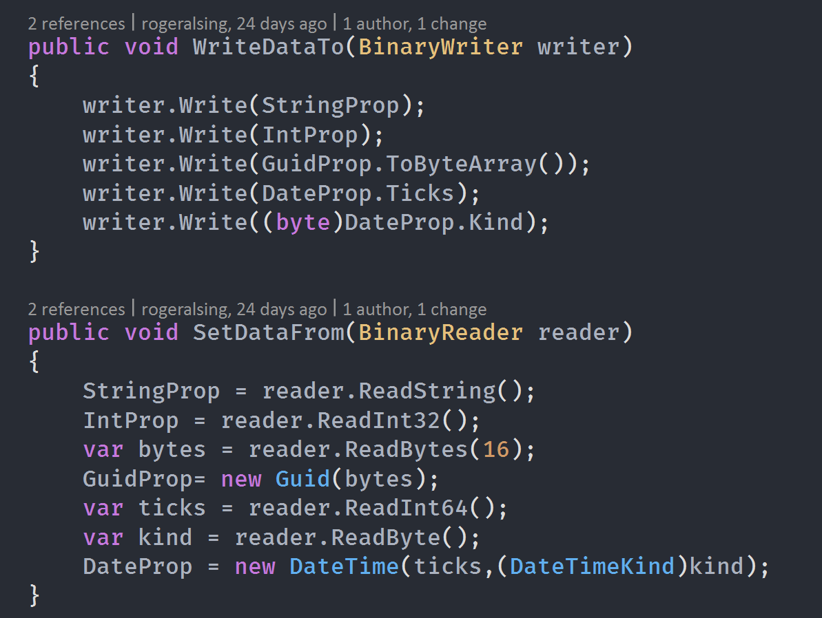
This session is about performance So, how fast is fast?
Comparing Wire to Greg Young’s custom manual serializer.

Slide 8
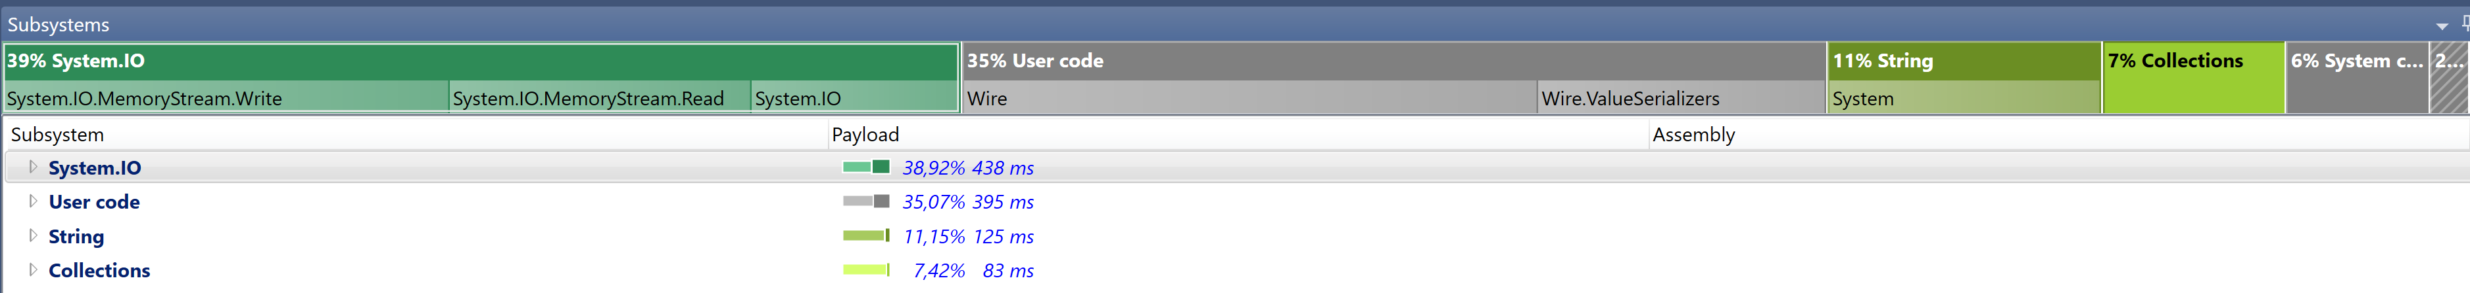

Slide 9
Let’s talk about code ☺

Slide 10
The basic architecture
Serializer – The main class, orchestrating everything
SerializerSession – Contains buffers and lookups for serialiazation.
DeserializerSession – Contains buffers and lookups for deserialization.
CodeGenerator – Responsible for emitting runtime generated code
ValueSerializer – Abstraction for serializing specific types
ValueSerializerFactory – Builder of custom ValueSerializers

Slide 11
Wire Schema
Type Manifest
Object Payload

Slide 12
Abstractions vs. Optimizations
Can we have both?
A peek into the ValueSerializer

Slide 13
Avoiding boxing
Original API used object for reading and writing. How do we make an API that can avoid this?
A peek into the ValueSerializer

Slide 14
Re-use buffers
Object allocations are expensive. How can we reduce the number of allocations?
A peek into SerializerSession / DeserializerSession

Slide 15
Stream Abstractions
MS Bond, Protobuf.NET use stream abstractions, is it faster?
https://github.com/mgravell/protobuf-net/blob/master/protobuf-net/BufferPool.cs

Slide 16
Re-use sessions
Same concept as the previous slide, but at a higher level.
Can we re-use anything between calls to Serialize/Deserialzie?

Slide 17
Handling Exotic Types
How do we handle Exotic types such as F# Lists etc.
A peek into the ValueSerializerFactory

Slide 18
Fast string -> Type lookups
A peek into the ByteArrayKey

Slide 19
Code generation
How do we generate code at runtime?
A peek into the DefaultCodeGenerator

Slide 20
Building your own compiler
Compiler abstraction ICompiler
IL Emit vs Linq.Expressions

Slide 21
Random Hacks
.NET Multi methods – ConsistentArraySerializer

